Slide 1
End-to-end ML Project
Fernando Carazo, PhD
Master de Innovación Tecnológica - 2021

Slide 2
1. Review of concepts -JARGON 2. ML pipeline 3. Proyecto Paraguas

Slide 3
JARGON
API | API-REST
Microservice
Docker
Json
Token
Endpoint
Slack
Agile - SCRUM
Backend vs frontend
Client vs server
DevOps
Model in production
Serve a model
Overfitting

Slide 4
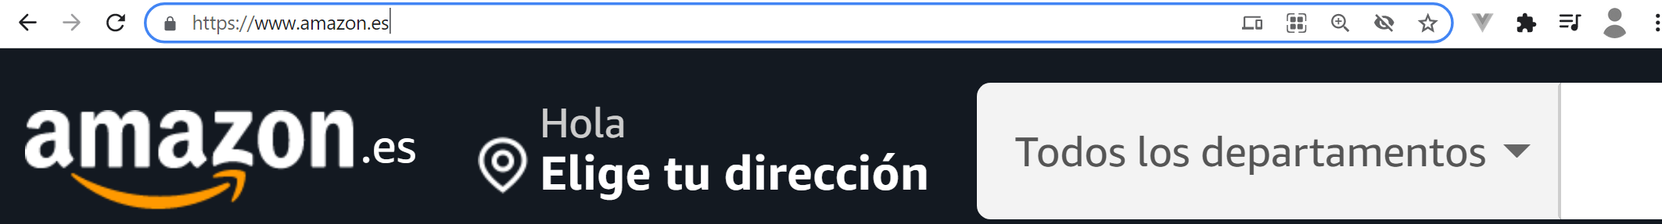
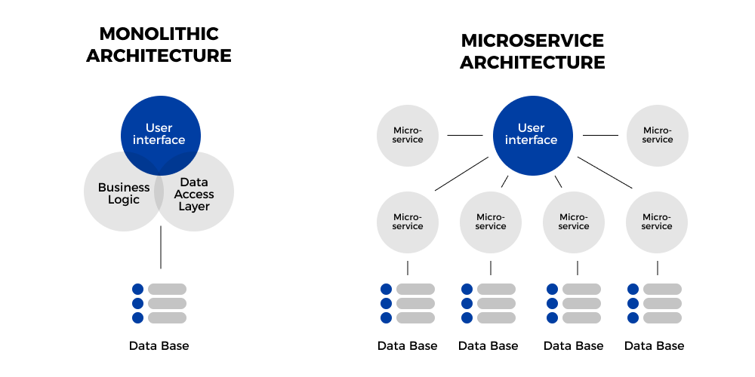
List microservices
Characteristics / functionality
Database/s

Slide 5
Stability
Scalability
Development Teams
Technology

Slide 6
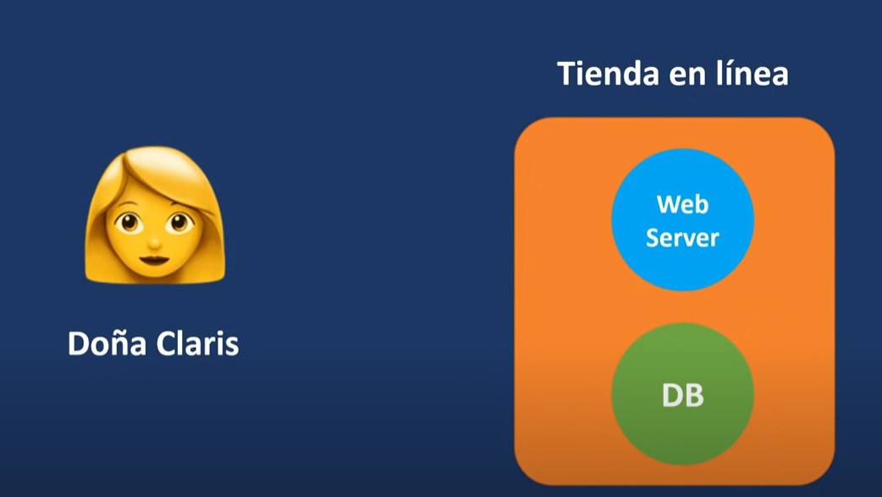
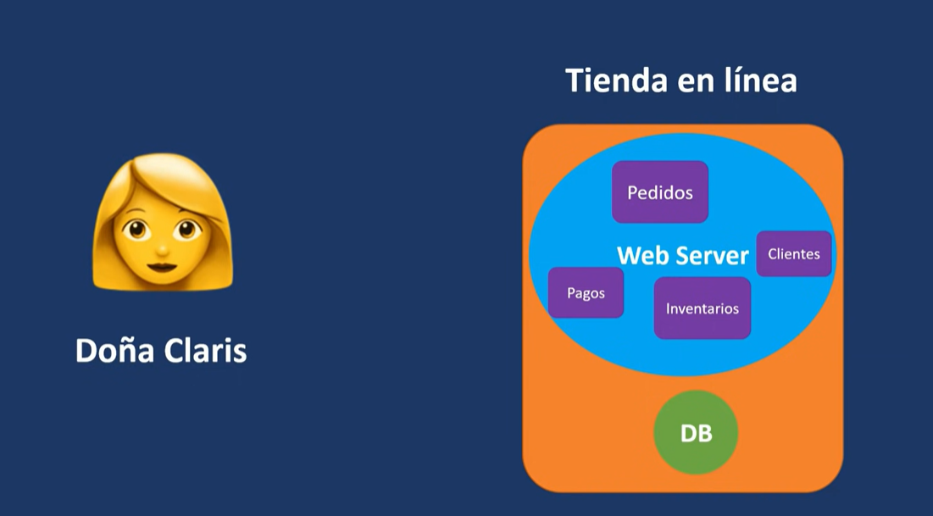

Slide 7
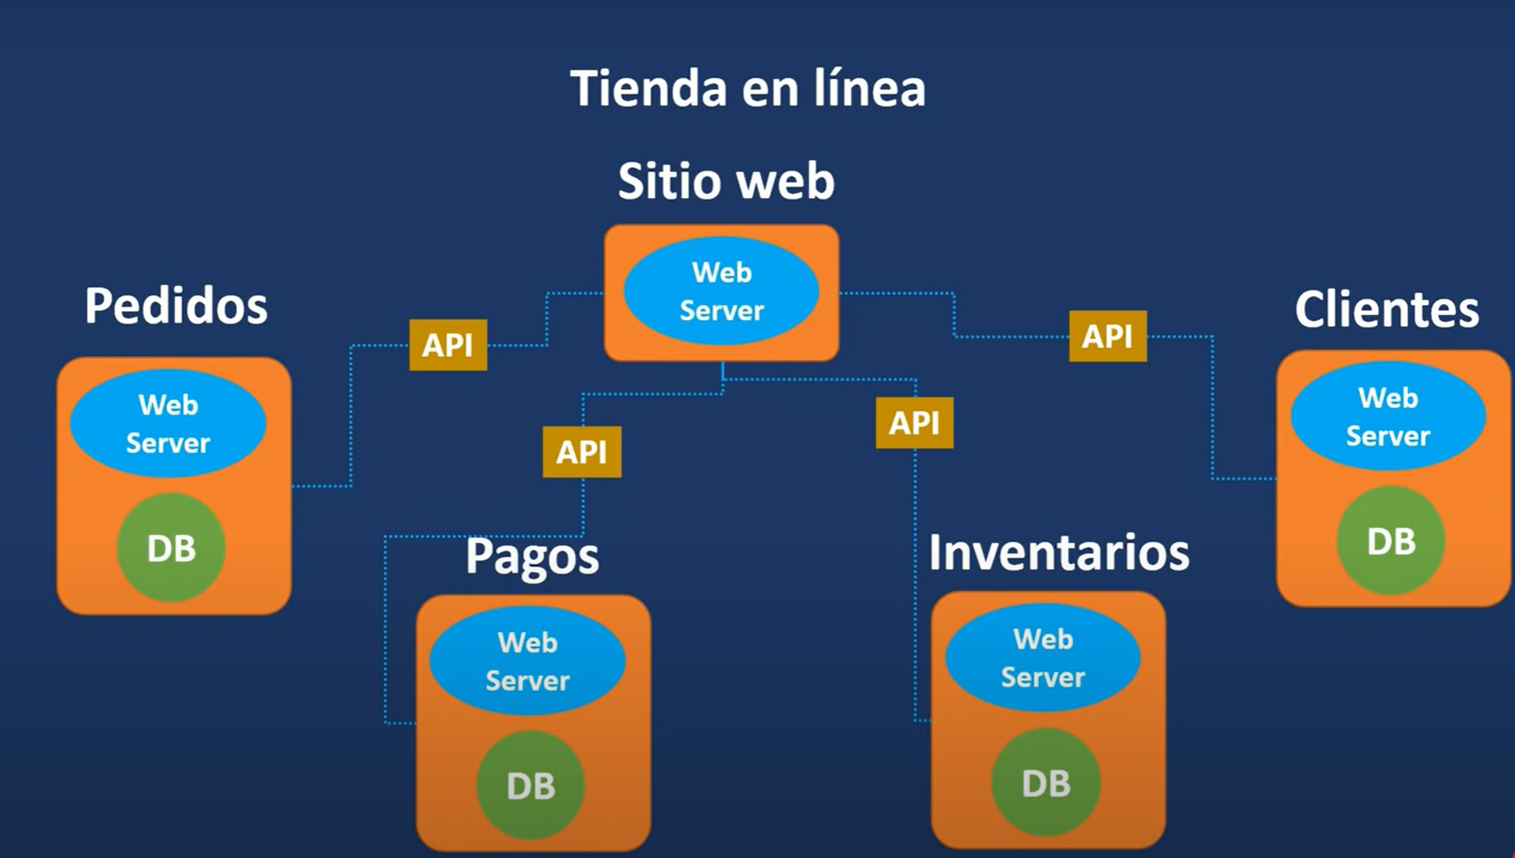

Slide 8

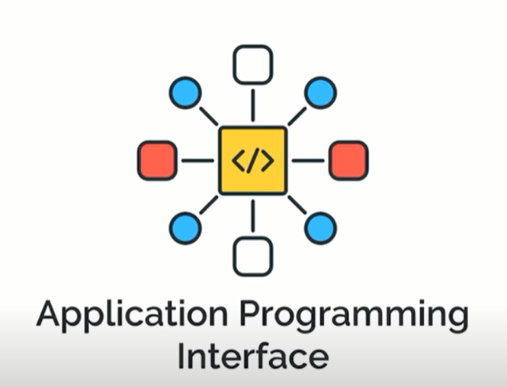
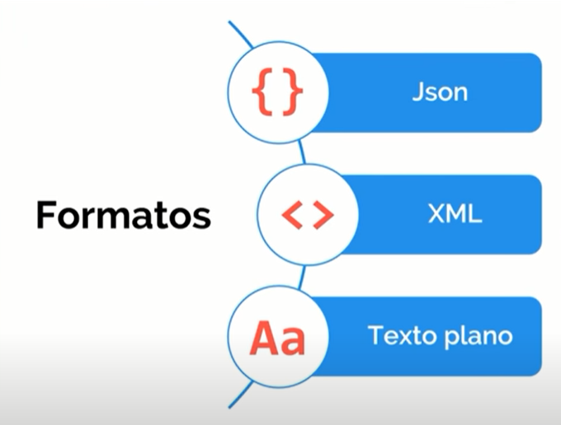
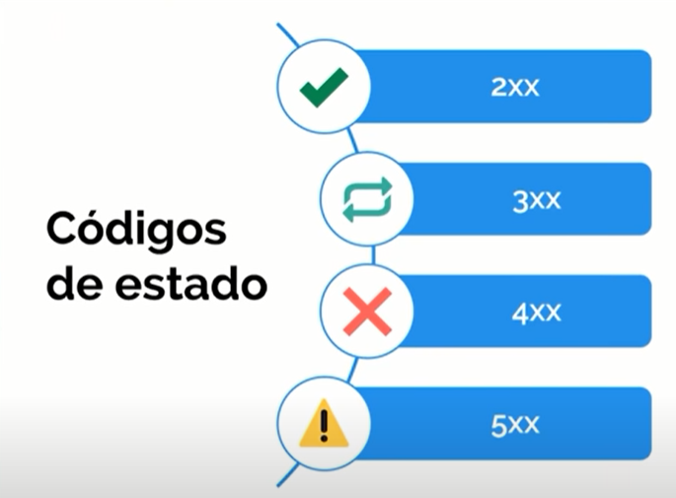
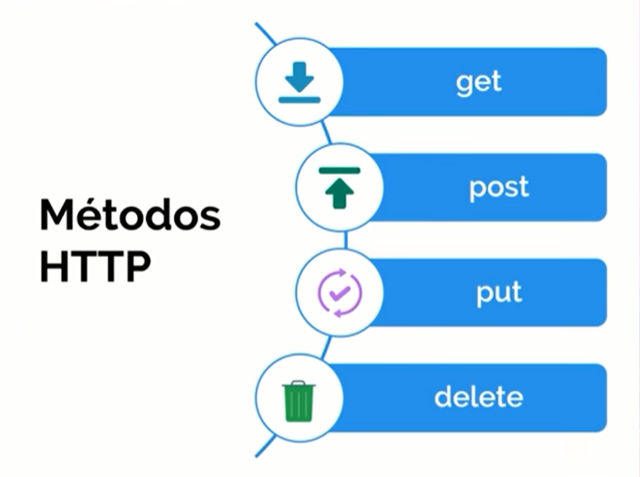
https://www.youtube.com/watch?v=u2Ms34GE14U

Slide 9
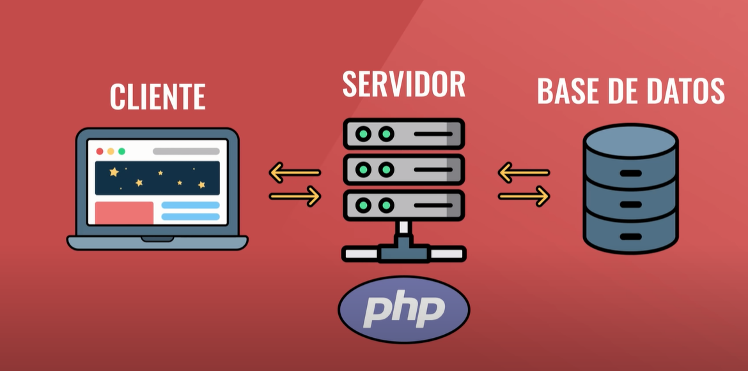

Slide 11
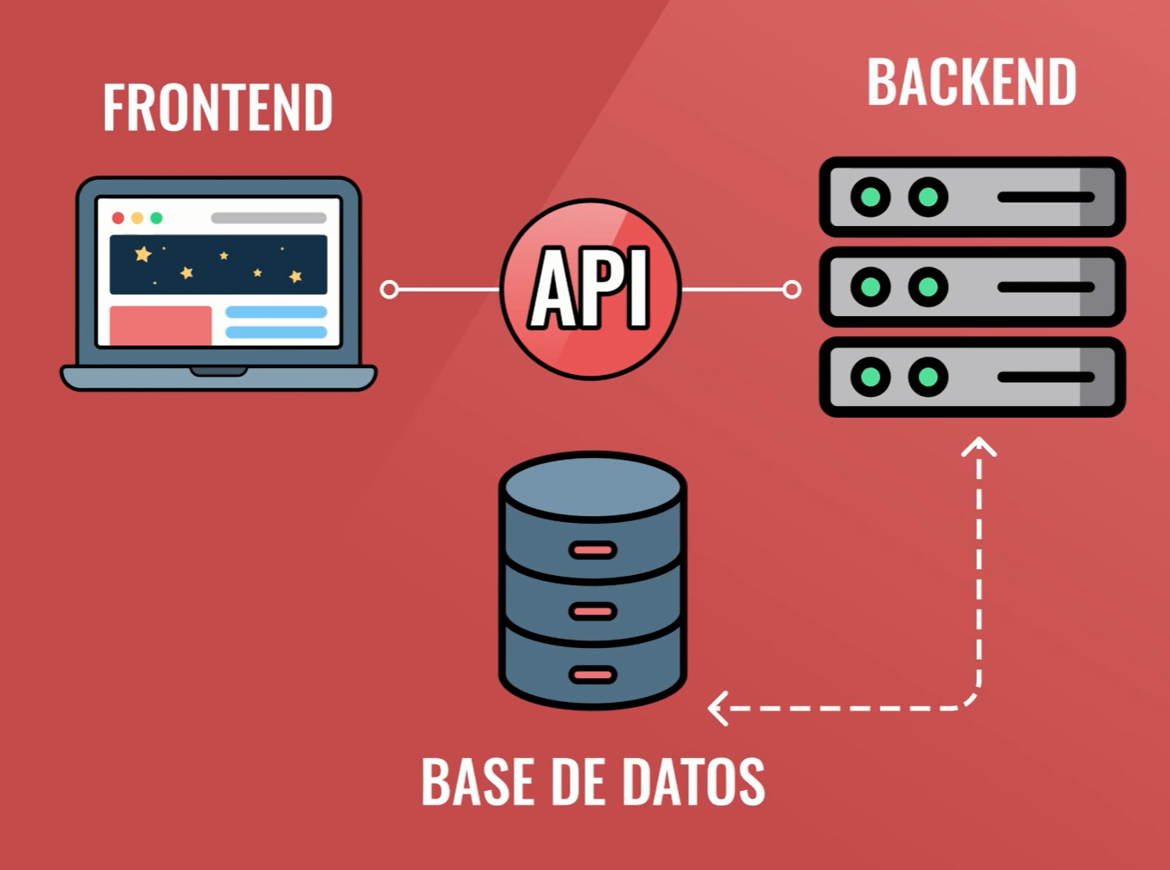

Slide 12

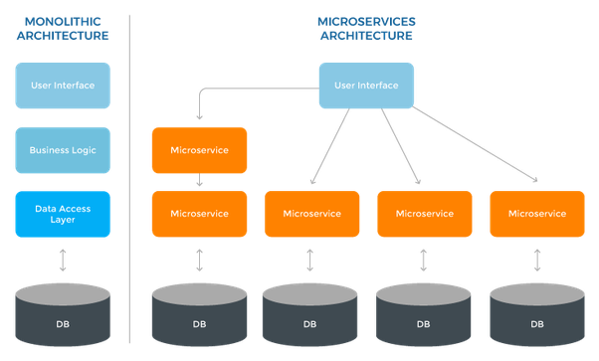
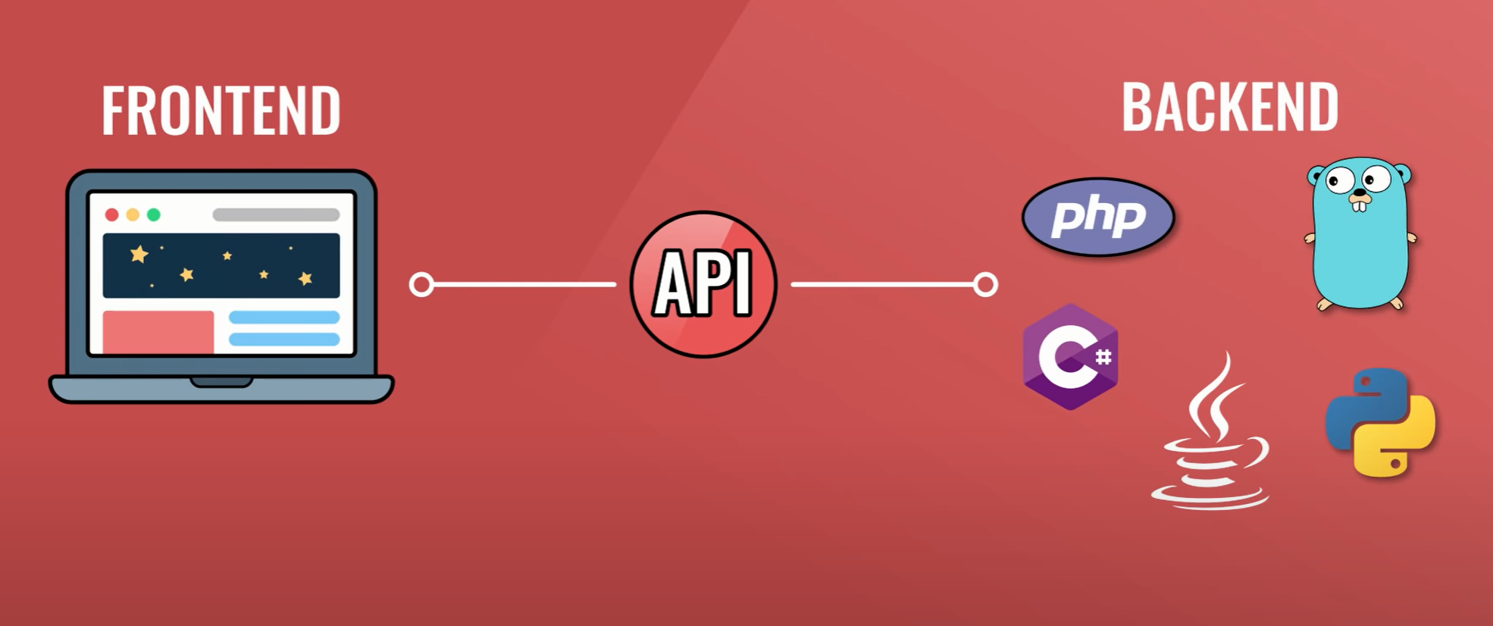

Slide 13
Frontend

Slide 15




Slide 16
Backend

Slide 17

Creation of APIs
Input and output
Ej. Text corrector
Ej. Departments
Ej. Recommendations
Ej. Historical search

Slide 18
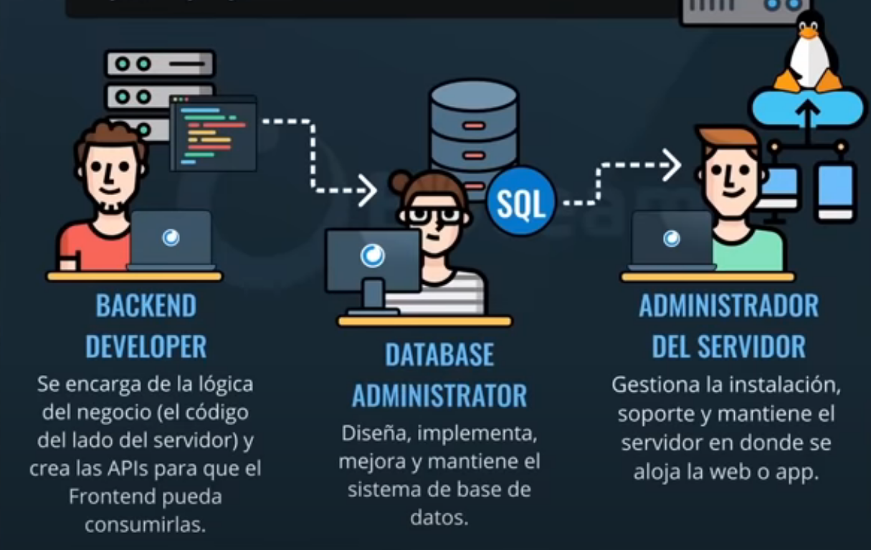

Slide 19
ML pipeline

Slide 20
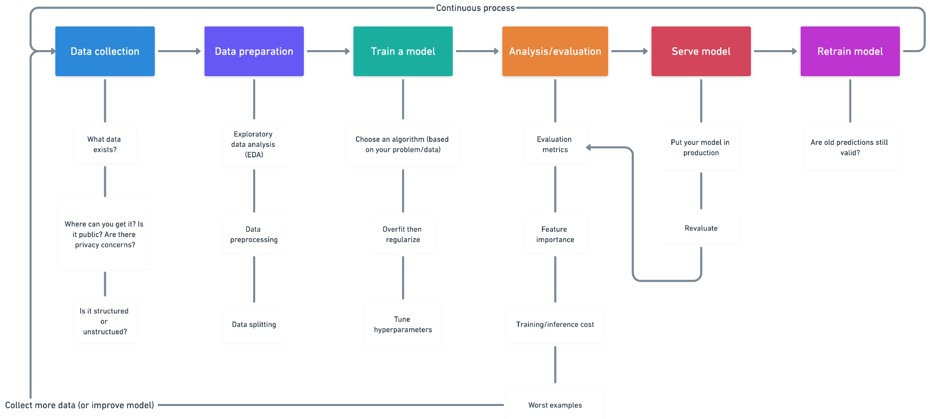
Exploratory analysis

Slide 21
Stages of a machine learning problem
Define the problem: What do you intend to predict? What data is available? o What data is necessary to obtain?
Success metric: define an appropriate way to quantify how good the results are.
1. Exploratory analysis
Make your own hypotheses and plot your data!!
2. Data preprocessing
Preprocess the data: apply the necessary transformations so that the data can be interpreted by the selected machine learning algorithm.
3. Model
Fit a first model capable of exceeding minimum results. For example, in classification problems, the minimum to overcome is the percentage of the majority class (the mode). In a regression model, the mean of the response variable.
Gradually improve the model by incorporating-creating new variables or optimizing the hyperparameters.
Evaluate the ability of the final model with the test set to have an estimate of the ability of the model when predicting new observations.

Slide 22
Main Challenges of Machine Learning
Insufficient quantity of training data
The unreasonable effectiveness of data
Non-representative training data
Sampling bias
Poor-quality data
Irrelevant features
Overfitting the training data
Underfitting the training data

Slide 23
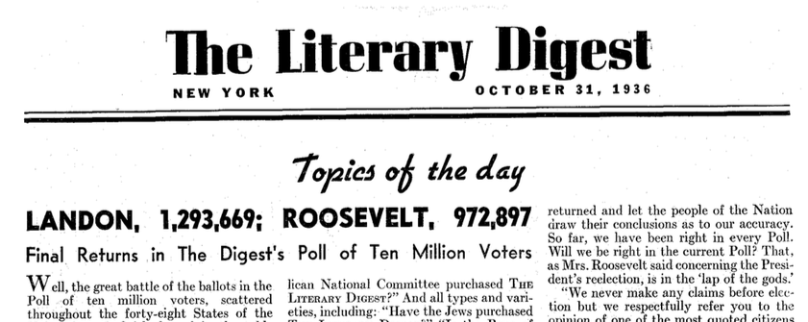
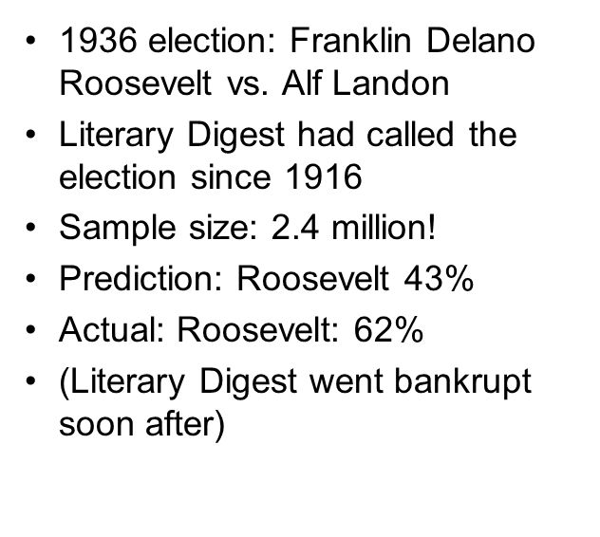

A Famous Example of Sampling Bias
Extra Information
• First, to obtain the addresses to send the polls to, the Literary Digest used telephone directories, lists of magazine subscribers, club membership lists, and the like.
• Second, less than 25% of the people who received the poll answered.
- Literary Digest was a weekly magazine with healthy recommendations and political articles

Slide 24
A Famous Example of Sampling Bias
• First, to obtain the addresses to send the polls to, the Literary Digest used telephone directories, lists of magazine subscribers, club membership lists, and the like. All of these lists tend to favor wealthier people, who are more likely to vote Republican (hence Landon).
• Second, less than 25% of the people who received the poll answered. Again, this introduces a sampling bias, by ruling out people who don’t care much about politics, people who don’t like the Literary Digest, and other key groups. This is a special type of sampling bias called nonresponse bias.

Slide 25
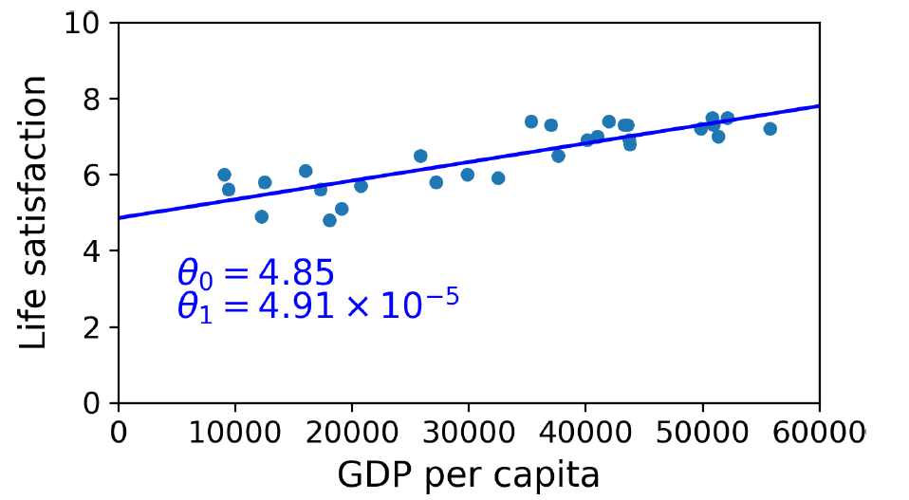
Non-representative training data

Slide 26
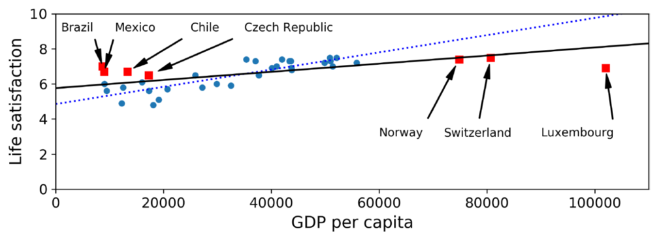
Non-representative training data

Slide 27
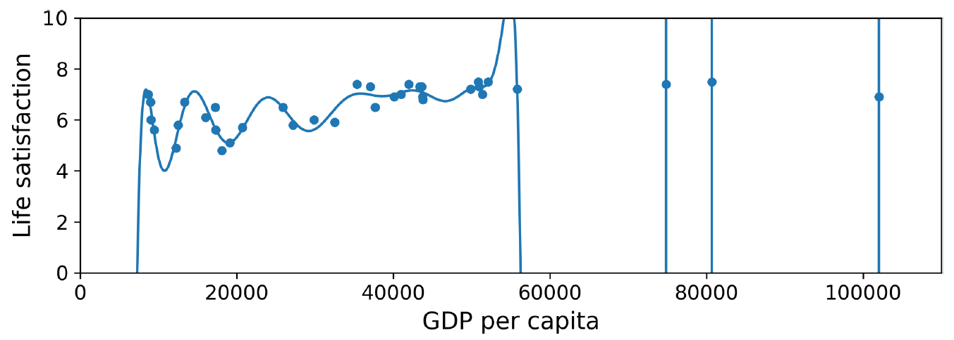
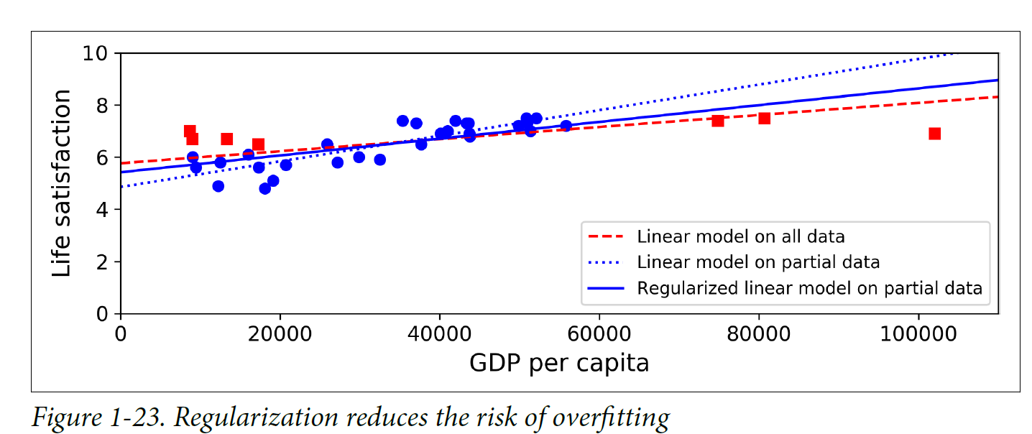
Overfitting the data
Explain bias-variance tradeoff.

Slide 28
1. Exploratory analysis
Type of each column
Number of observations, missing values and outliers
Response variable
Numerical variables
Numerical variables correlation
Qualitative variables
PLOT, TABLES and view your data!!! Seaborn and plotly
https://seaborn.pydata.org/api.html
https://plotly.com/python/plotly-express/
See docs 01.01, 01.02 and 02.01

Slide 29
2. Data preprocessing
Train and test division → evaluation in CV
Imputation of missing values
Exclusion of variables with variance close to zero
Power transformations
Standardization and scaling of numerical variables
Binarization of qualitative variables
Pipeline and ColumnTransformer

Slide 30
3. Model
Create a (simple) model
Training
Validation
Prediction
Test error
Hyperparameters (tuning)

